Slide 1
GRADE 7 ACCELERATED · UNIT 2 · LESSON 5
Rational and Irrational Numbers on the Number Line
MA.8.NSO.1.2
I can order and compare any set of real numbers, and plot them.
Every number you have met this unit has one place on the line.
Today is deciding which place, and which of two is greater.
Grade 7 Accelerated · Unit 2 · Lesson 5 — Rational and Irrational Numbers on the Number Line
1

Slide 2
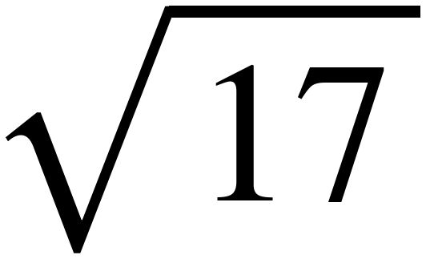
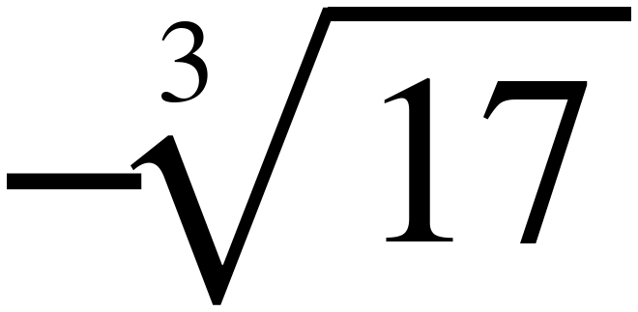
Warm-Up
On your own. Four minutes.
Same and different
What is the same about these two, and what is different?
Grade 7 Accelerated · Unit 2 · Lesson 5 — Rational and Irrational Numbers on the Number Line
2

Slide 3
Notes
I. Every real number has exactly one place on the line
A.
Rational or irrational, fraction or root or decimal — one number, one point.
B.
The form it is written in does not move it. √4 and 2 are the same point.
Grade 7 Accelerated · Unit 2 · Lesson 5 — Rational and Irrational Numbers on the Number Line
3

Slide 4
Notes
II. Turn every number into a decimal first
A.
Compare decimals, then write the answer back in the original form.
B.
Two places is enough for everything on this worksheet.
C.
A root that comes out even is not an estimate — write it exactly.
Grade 7 Accelerated · Unit 2 · Lesson 5 — Rational and Irrational Numbers on the Number Line
4

Slide 5
Notes
III. With negatives, further left is smaller
A.
−2 is greater than −5, even though 5 is greater than 2.
B.
So the bigger the root, the further LEFT a negative sits.
C.
−√50 is less than −√49. The radicand went up and the value went down.
Grade 7 Accelerated · Unit 2 · Lesson 5 — Rational and Irrational Numbers on the Number Line
5

Slide 6
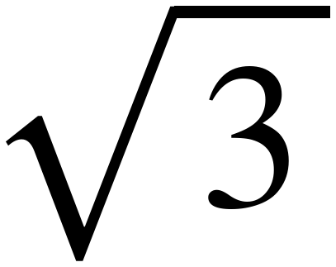
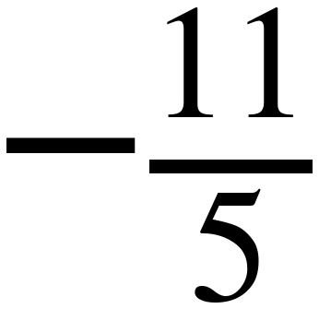

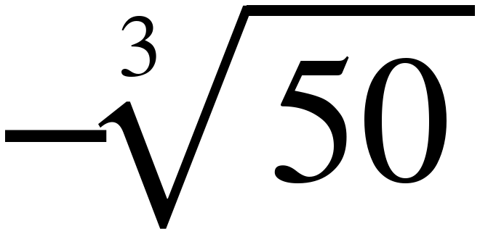
Example 1
Nothing on paper yet. Answer out loud.
1.
Which of the four are irrational?
2.
Which one is furthest left, before you compute anything?
3.
Which two are you least sure about?
Grade 7 Accelerated · Unit 2 · Lesson 5 — Rational and Irrational Numbers on the Number Line
6

Slide 7
Example 1
Now the decimals. Two places each.
Fill these in before you order anything.
Grade 7 Accelerated · Unit 2 · Lesson 5 — Rational and Irrational Numbers on the Number Line
7

Slide 8
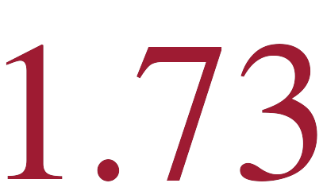

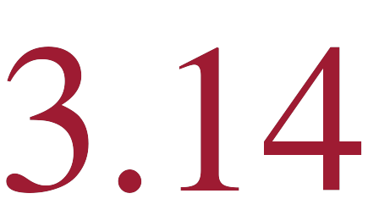
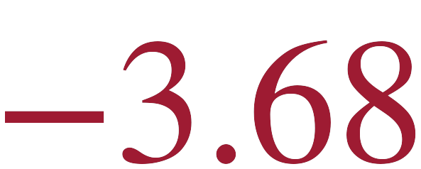
Example 1
The decimals, checked.
Grade 7 Accelerated · Unit 2 · Lesson 5 — Rational and Irrational Numbers on the Number Line
8

Slide 9

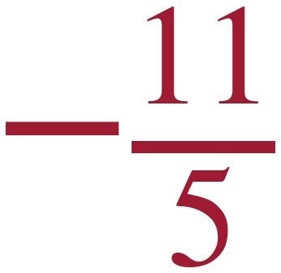
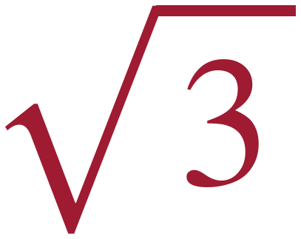

Example 1
Least to greatest.
−3.68 < −2.20 < 1.73 < 3.14
Grade 7 Accelerated · Unit 2 · Lesson 5 — Rational and Irrational Numbers on the Number Line
9

Slide 10
Example 2
Marisol's work. Something is wrong.
“−√50 is greater than −7, because 50 is greater than 49.”
Find the error.
Grade 7 Accelerated · Unit 2 · Lesson 5 — Rational and Irrational Numbers on the Number Line
10

Slide 11
Example 2
Name the error.
1.
50 > 49 — true.
2.
√50 > √49 — true.
3.
−√50 > −7 — false. The negative sign reverses it.
Grade 7 Accelerated · Unit 2 · Lesson 5 — Rational and Irrational Numbers on the Number Line
11

Slide 12

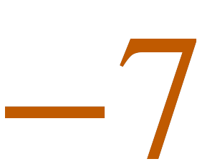
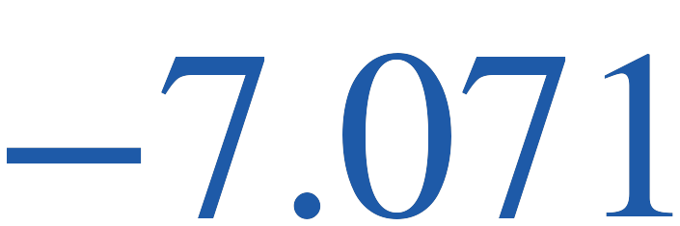

Example 2
Fix it.
vs
vs
−√50 < −7
Grade 7 Accelerated · Unit 2 · Lesson 5 — Rational and Irrational Numbers on the Number Line
12

Slide 13
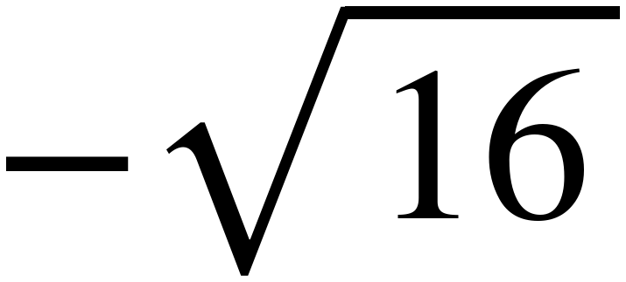
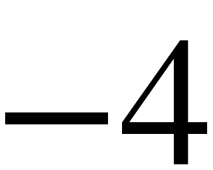
Whiteboards · Question 1 of 9
Boards up on three.
Compare the two numbers.
Write <, > or =.
Grade 7 Accelerated · Unit 2 · Lesson 5 — Rational and Irrational Numbers on the Number Line
13

Slide 14

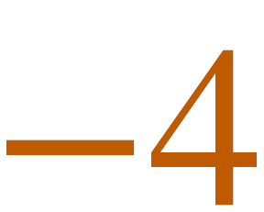


Whiteboards · Question 1 of 9
Answer.
vs
Answer: =
Grade 7 Accelerated · Unit 2 · Lesson 5 — Rational and Irrational Numbers on the Number Line
14

Slide 15
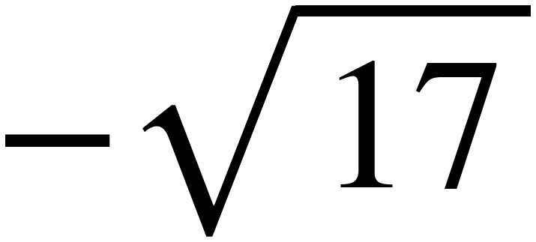
Whiteboards · Question 2 of 9
Boards up on three.
Compare the two numbers.
Write <, > or =.
Grade 7 Accelerated · Unit 2 · Lesson 5 — Rational and Irrational Numbers on the Number Line
15

Slide 16

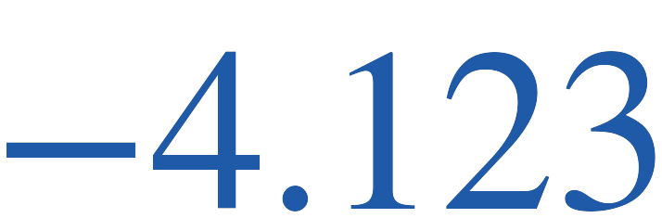
Whiteboards · Question 2 of 9
Answer.
vs
Answer: <
Grade 7 Accelerated · Unit 2 · Lesson 5 — Rational and Irrational Numbers on the Number Line
16

Slide 17
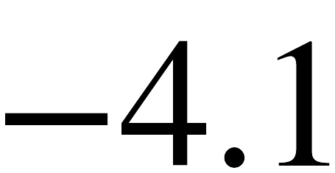
Whiteboards · Question 3 of 9
Boards up on three.
Compare the two numbers.
Write <, > or =.
Grade 7 Accelerated · Unit 2 · Lesson 5 — Rational and Irrational Numbers on the Number Line
17

Slide 18
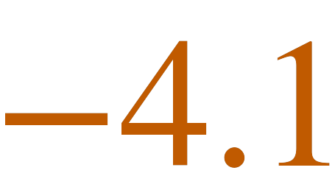

Whiteboards · Question 3 of 9
Answer.
vs
Answer: <
Grade 7 Accelerated · Unit 2 · Lesson 5 — Rational and Irrational Numbers on the Number Line
18

Slide 19
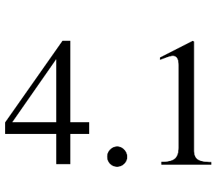
Whiteboards · Question 4 of 9
Boards up on three.
Compare the two numbers.
Write <, > or =.
Grade 7 Accelerated · Unit 2 · Lesson 5 — Rational and Irrational Numbers on the Number Line
19

Slide 20

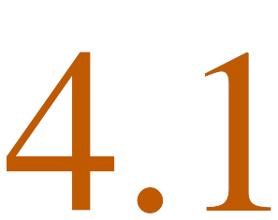
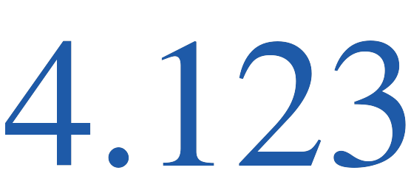
Whiteboards · Question 4 of 9
Answer.
vs
Answer: >
Grade 7 Accelerated · Unit 2 · Lesson 5 — Rational and Irrational Numbers on the Number Line
20

Slide 21
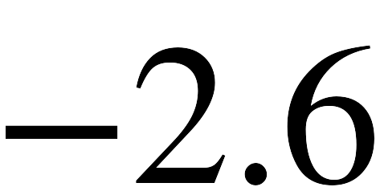
Whiteboards · Question 5 of 9
Boards up on three.
Compare the two numbers.
Write <, > or =.
Grade 7 Accelerated · Unit 2 · Lesson 5 — Rational and Irrational Numbers on the Number Line
21

Slide 22
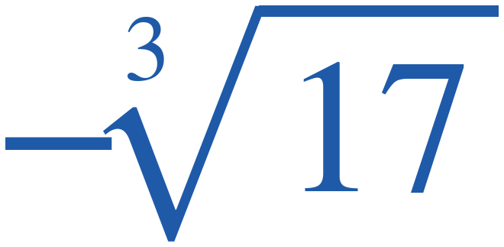
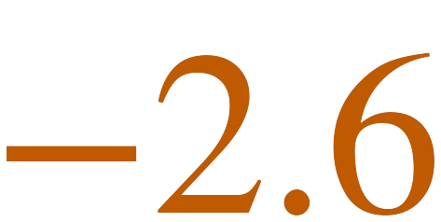
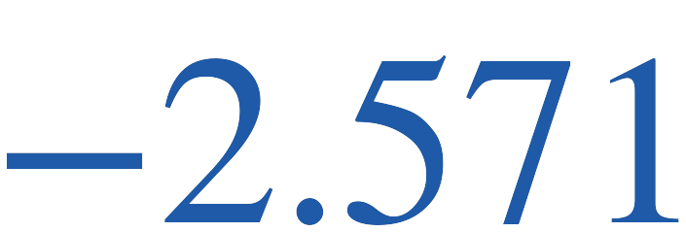
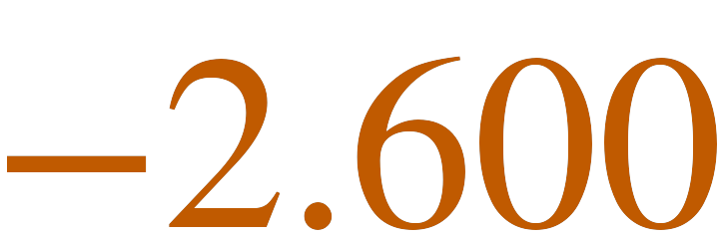
Whiteboards · Question 5 of 9
Answer.
vs
Answer: >
Grade 7 Accelerated · Unit 2 · Lesson 5 — Rational and Irrational Numbers on the Number Line
22

Slide 23
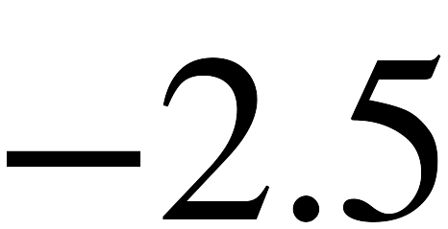
Whiteboards · Question 6 of 9
Boards up on three.
Compare the two numbers.
Write <, > or =.
Grade 7 Accelerated · Unit 2 · Lesson 5 — Rational and Irrational Numbers on the Number Line
23

Slide 24
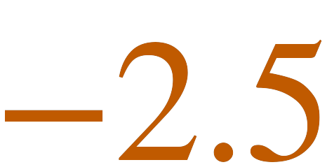
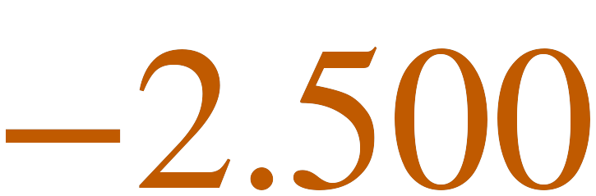
Whiteboards · Question 6 of 9
Answer.
vs
Answer: <
Grade 7 Accelerated · Unit 2 · Lesson 5 — Rational and Irrational Numbers on the Number Line
24

Slide 25
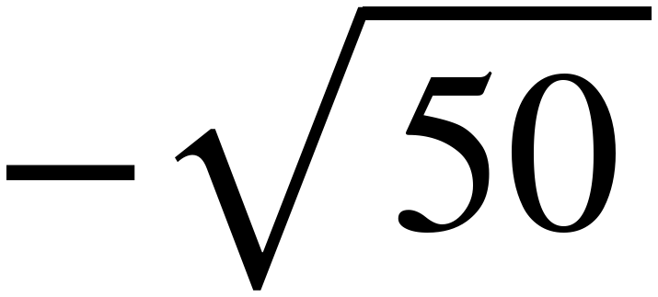
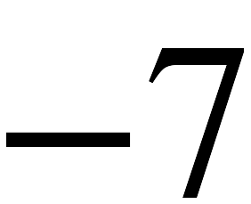
Whiteboards · Question 7 of 9
Boards up on three.
Compare the two numbers.
Write <, > or =.
Grade 7 Accelerated · Unit 2 · Lesson 5 — Rational and Irrational Numbers on the Number Line
25

Slide 26
Whiteboards · Question 7 of 9
Answer.
vs
Answer: <
Grade 7 Accelerated · Unit 2 · Lesson 5 — Rational and Irrational Numbers on the Number Line
26

Slide 27
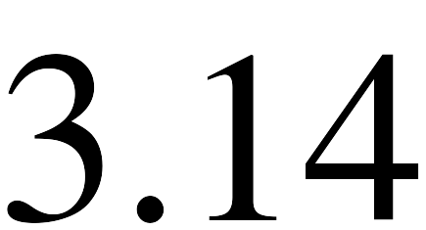
Whiteboards · Question 8 of 9
Boards up on three.
Compare the two numbers.
Write <, > or =.
Grade 7 Accelerated · Unit 2 · Lesson 5 — Rational and Irrational Numbers on the Number Line
27

Slide 28


Whiteboards · Question 8 of 9
Answer.
3.14159…
vs
3.14000
Answer: >
Grade 7 Accelerated · Unit 2 · Lesson 5 — Rational and Irrational Numbers on the Number Line
28

Slide 29
Whiteboards · Question 9 of 9
Take your time. Boards up when you have written it.
Jess says −√17 is greater than −4, because 17 is greater than 16. Is she right?
Write your answer in sentences.
This one is written work. Say which part of her reasoning is correct.
Grade 7 Accelerated · Unit 2 · Lesson 5 — Rational and Irrational Numbers on the Number Line
29

Slide 30
Whiteboards · Question 9 of 9
Answer.
Jess says −√17 is greater than −4, because 17 is greater than 16. Is she right?
−√17 = −4.123, which is LEFT of −4
Answer: No — it is less
Grade 7 Accelerated · Unit 2 · Lesson 5 — Rational and Irrational Numbers on the Number Line
30

Slide 31
IXL
Last five minutes.
1.
Open IXL and start today's skills.
2.
Work on paper where the question needs work. The answer box does not show it.
3.
Whatever you do not finish is tonight's practice.
4.
The skills for today are posted in Google Classroom.
Grade 7 Accelerated · Unit 2 · Lesson 5 — Rational and Irrational Numbers on the Number Line
31

